Slide 1
Bash Dictionary Project
Eva BENOIT – Ariane BERTRAND – Guillaume FORMEY DE SAINT LOUVENT – Ang LI

Slide 2
Table of Contents
I. Project Presentation
II. Stardict – Off line dictionary
1) Stardict Presentation
2) Stardict Launch
III. Shelldict – On line dictionary
1) Shelldict Presentation
2) Commands Used
Conclusion
2

Slide 3
I. Project Presentation
3

Slide 4
Bash Dictionary Project
We wanted a user to be able to look for the meaning of a word without having to search for a dictionary website, only using a command-line dictionary
It should be available both:
Off line
And online
It should be simple , easy to use and accessible for all
Solution chosen:
Use an existing Linux OS off-line dictionary: Stardict
Create our own bash application: Shelldict
We choose to use only English dictionaries
4

Slide 5
Stardict Presentation
Stardict Launch
II. Stardict – Off line dictionary
5

Slide 6

II.1 Stardict Presentation
What is Stardict:
An international dictionary shell
Also serves as a translator
Actual version: 3.0.2
Cross-platform operating system
Linux, Windows, Mac OS X…
Compatible also with mobile platforms
Android, iOS, Windows phone…
Why use Stardict:
Has an efficient off line dictionary
Provides a great choice of dictionaries
Easy to access
Free graphical user interface
6

Slide 7
II.2 Stardict Launch
How to install it:
1. Install the dictionary
command line : sudo apt-get install sdcv
(sdcv is the console version of stardict)
2. Download dictionary files
Go to http://abloz.com/huzheng/stardict-dic/dict.org/, and download the dictionary you need.
(At first Stardict doesn’t have any dictionary)
3. Install downloaded dictionaries
Command line :
sudo mkdir -p /usr/share/stardict/dic/
sudo tar -xvjf downloaded.tar.bz2 -C /usr/share/stardict/dic
7

Slide 8
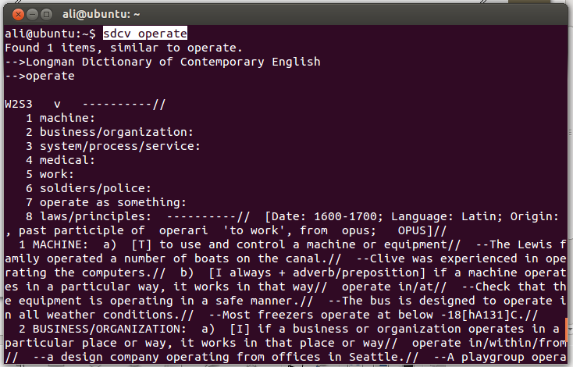
II.2 Stardict Launch
How to launch stardict in terminal:
command line : sdcv word
(''word'' is the word to be searched for definition)
8

Slide 9
Selldict Presentation
Main Functions
III. Shelldict – Online dictionary
9

Slide 10

III.1 Shelldict Presentation
We created our own Bash dictionary : Shelldict
It uses an already existing online dictionary:
Oxford Dictionaries: http://www.oxforddictionaries.com/
Reference in terms of English dictionaries
Has been making dictionaries for 150 years
10

Slide 11
III.2 Main Functions
11

Slide 12
Conclusion
12

Slide 13
Conclusion
At the end of this project a user is now able to find definitions of
words in both online and off line dictionaries.
This experience allowed us to use what we learned
theoretically during this class.
More details about the code lines are presented above.
If we had more time we would have liked to create a graphic interface.
An other implementation could have been to send a mail to a
web service that will call the dictionary and receive a mail back
with the definition of the word.

